Slide 1
VHDL Project
Design a floating point multiplier in VHDL
Made by:
Aryaman Maheswari (16114018)
Aviral Verma (16114019)
Hasanwala Faizal (16114030)

Slide 2
IDEA
Represent floating point using IEEE standards.
Operate on the different parts i.e. Sign bit, mantissa and exponent.
Combine them back together.
Take care of corner cases.

Slide 3
IEEE – 754
Represent the floating point number in standard form with exponent and mantissa. The exponent’s base should be 2.
First bit represents the sign.
Add 127 to the exponent and convert to binary.
8 bits assigned to exponent.
For the mantissa, represent only its fractional part in the 23 bits assigned to it.
S EEEEEEEE MMMMMMMMMMMMMMMMMMMMMMM
We better show this with an example.

Slide 4
Example
Let’s take the floating number = 12.5
We first represent it as : 1.5625 x 2³
The exponent = 3
The sign bit = 0
The mantissa bits will represent only 0.5625.
Hence the final number comes out to be:
0 10000010 10010000000000000000000

Slide 5

Inputs & Outputs
We have taken two binary number of length 32 as inputs.
Output is formed from three variables:
1. Sign
2. Exponent
3. Mantissa

Slide 6
Procedure
Divide the numbers into three parts : Sign bit, mantissa and the exponent.
Operate on them individually and combine back the results.

Slide 7
The Sign Bit
1 represents negative and 0 represents positive.
Hence to find the sign bit of the product, we essentially have to take XOR of the sign bits of the numbers.
-1 | -1 | 1
1 | -1 | -1
-1 | 1 | -1
1 | 1 | 1
Product Table
1 | 1 | 0
0 | 1 | 1
1 | 0 | 1
0 | 0 | 0
Xor Table

Slide 8
Mantissa
In a 32 bit floating point number , 23 bits are dedicated to determine the mantissa.
The mantissa of product is calculated by the binary multiplication of 23 bits of the operands.
This is achieved by implementing the following code.

Slide 9
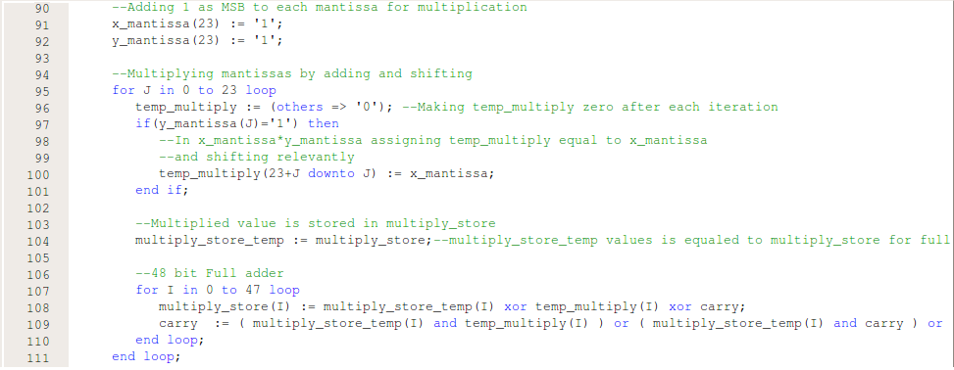

Slide 10
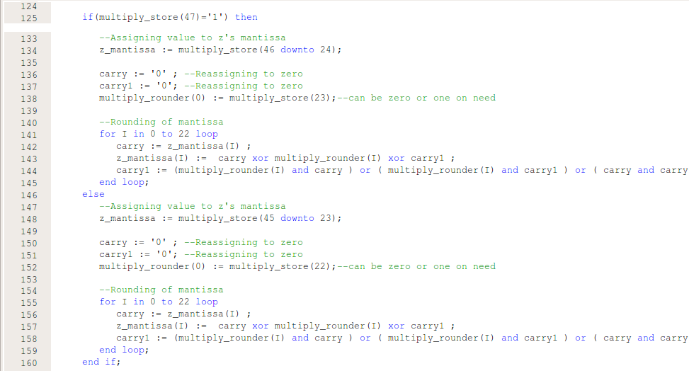

Slide 11
Exponent
8 bits are allocated to represent the exponent of the floating point number.
Exponent of the product is calculated by the addition of exponents of the two operands and then subtracting 127 from it.
This is achieved by the following block of code.

Slide 12
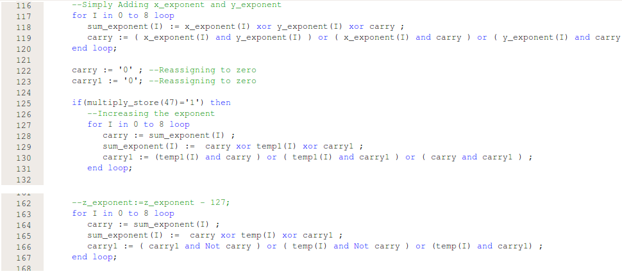

Slide 13
Overflow condition
When magnitude of number is too large to represent
Condition recognized by exponent_sum’s 8th bit is 1 and 7th bit is 0.
In such case output is positive infinity or negative infinity
Largest magnitude value 8388607 * 2⁺¹²⁷

Slide 14
Underflow condition
When magnitude of number is too small to represent
Condition recognized by exponent_sum’s 8th bit and 7th bit is 1.
In such case output is positive zero or negative zero (practically both values turn out to be same).
Smallest magnitude value 1 * 2⁻¹²⁸

Slide 15
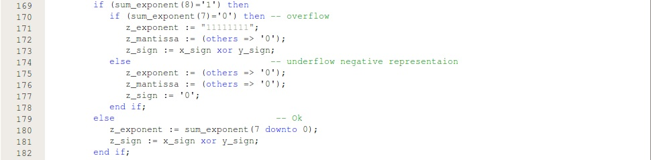

Slide 16
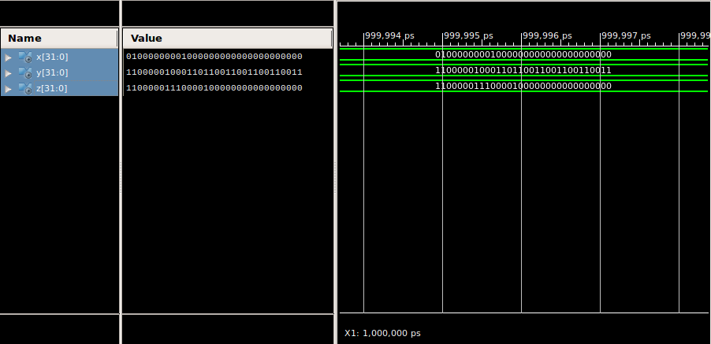
Stimulation

